Slide 1
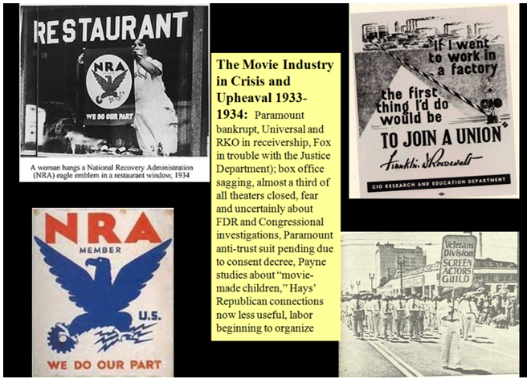

Slide 2
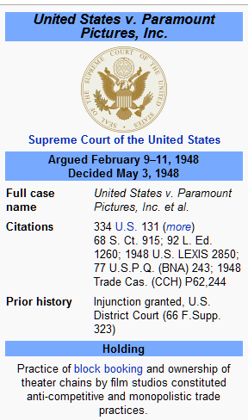
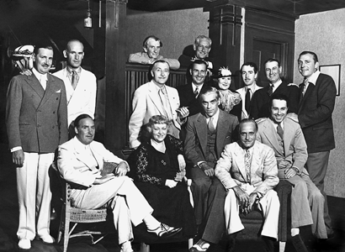
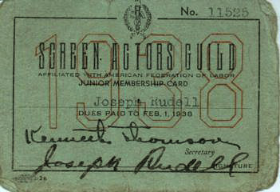
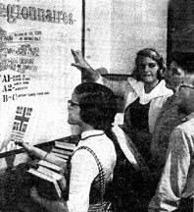
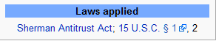
Worried, Ambitious Moguls and Grateful Artists
The NRA codes accepted the studio system by establishing a single code for production, distribution, and exhibition (rather than separate codes for buyers and sellers as in other industries). But the NRA ruled in favor of independent exhibitors on block booking and double features and later initiated the Paramount anti-trust suit. Meanwhile, section 7A of the NRA initiated a decade of labor struggles, including those of SAG where (despite RR’s recollection) the stars joined the union to protect their own huge salaries.

Slide 3
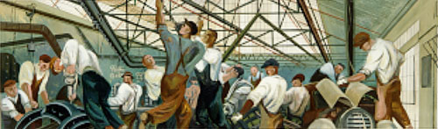
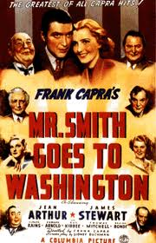
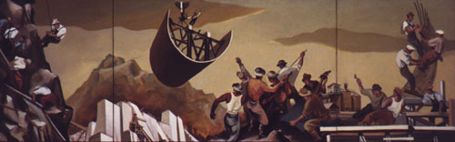
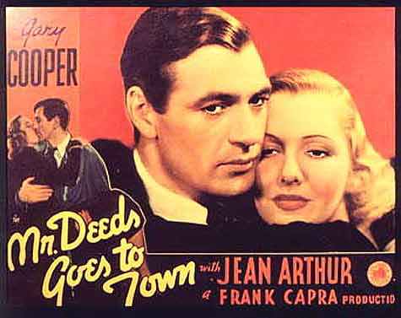
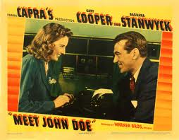
“Any wholesome influence emanating from the photoplay,” Munsterberg concluded, “must have an incomparable power for the remolding and upbuilding of the national soul." Sklar, 125-126

Slide 4
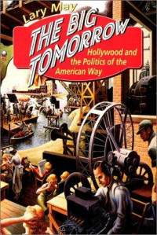
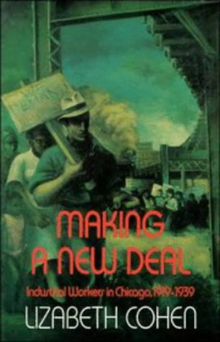
Mass Culture in the Age of Movies: Images and the Political Process
The new media - movies, radio, phonograph – “and their special kind of appeal helped reinforce a social order rapidly disintegrating under economic and social pressures that were too great to endure,” and “helped create an environment in which the sharing of common experiences, be they of hunger, dustbowls, or war, made the uniform demand for action and reform more striking and urgent....” The proliferation of images created “an unusual sense of sight and sound, a peculiar interest in symbol, myth, and language, created a novel kind of community, breaking down barriers, creating often new common experiences for millions.” - Susman, “The Culture of the Thirties,” in Culture as History.
Cohen and May suggest the ways movies provided a common culture upon which working people could unit and carved out new places for multi-cultural voices in that culture.

Slide 5
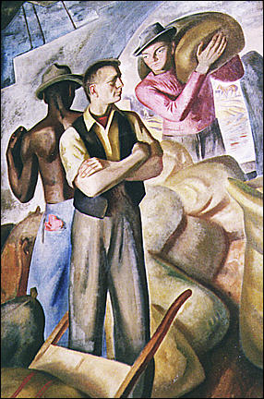
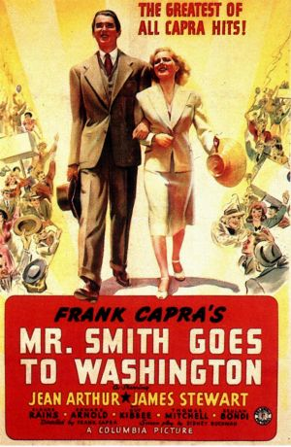
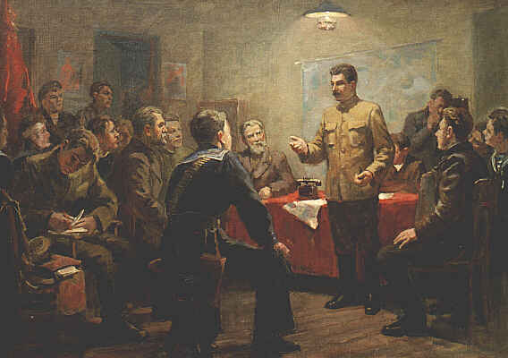
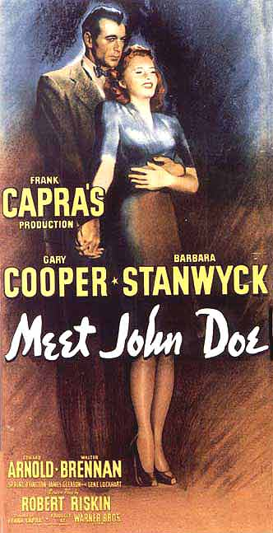
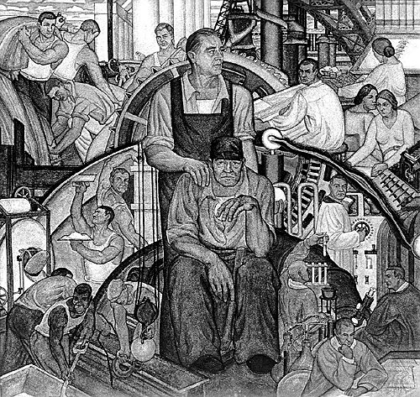
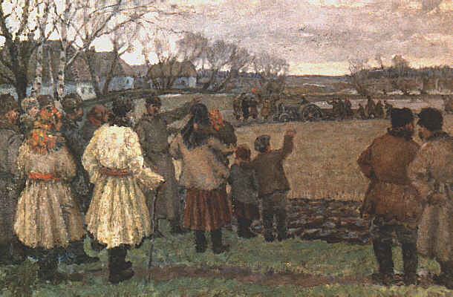
Socialist Realism and “Capitalist (or New Deal ) Realism”

Slide 6
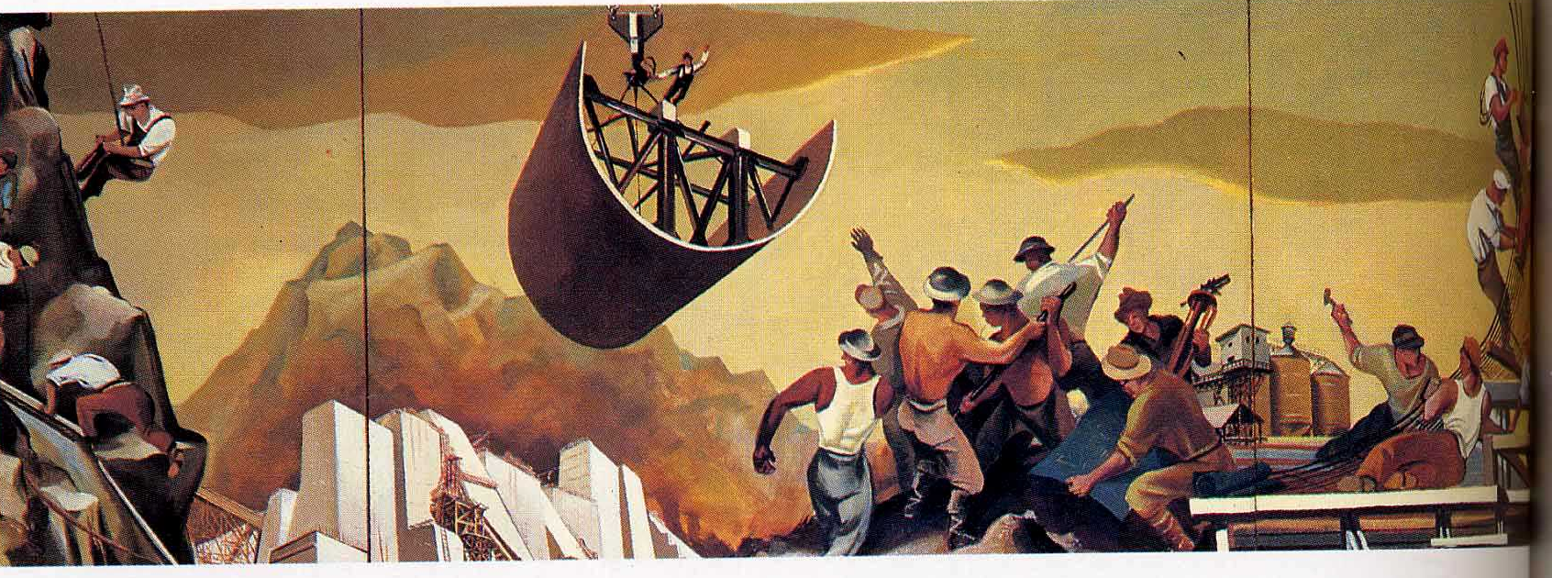
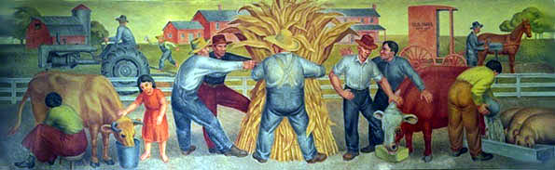
THE POPULAR FRONT
AGAINST FACSISM
William Gropper, cartoonist for the left-wing New Masses, did the top mural for the Department of Interior Building

Slide 7
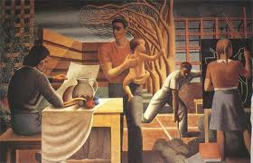
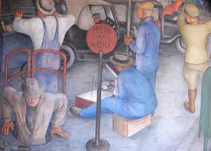
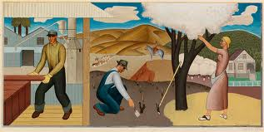
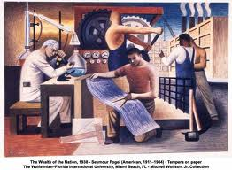
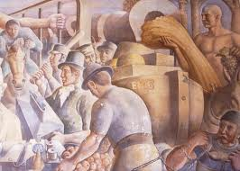
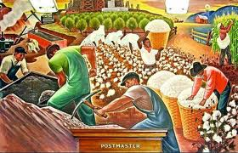
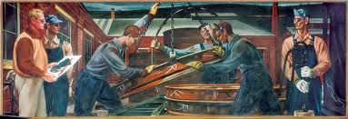

Slide 8
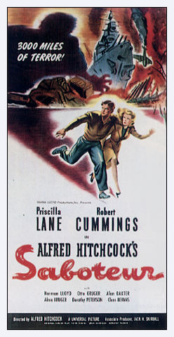
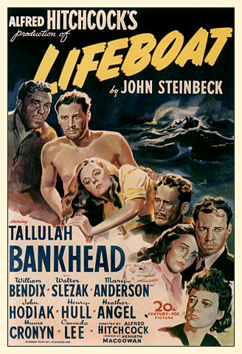
The Politics of Image-Making at its best? Consider Hitchcock’s Saboteur (1942) and Lifeboat (1944)

Slide 9
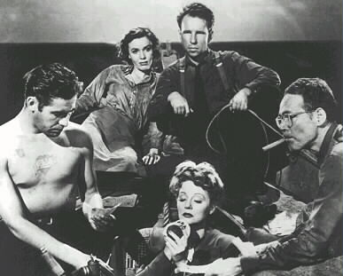
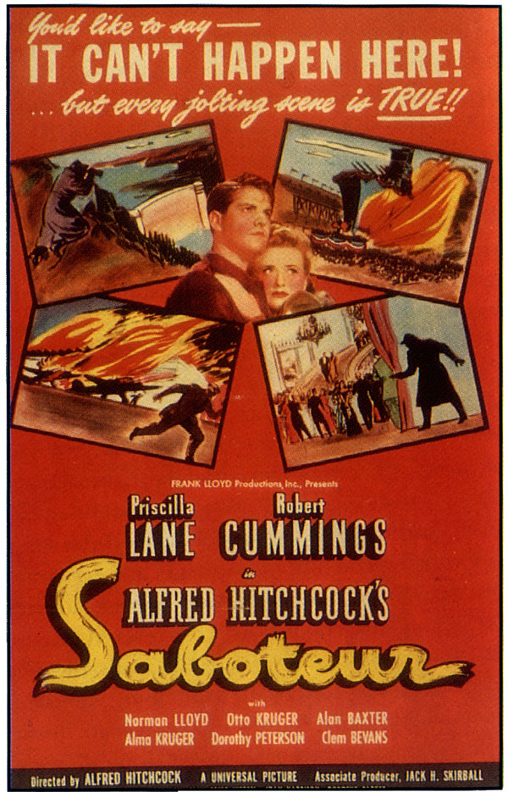
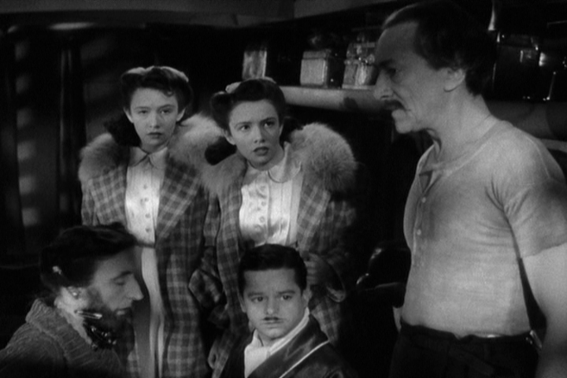
Hitch enlists in the Popular Front Against Fascism
Lifeboat (1944)
Saboteur 1942
Manipulating emotions or demanding ratiocination?

Slide 10
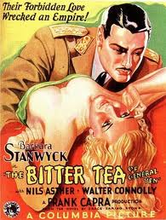
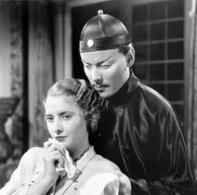
Sklar defines fantasy as “a way of pleasing audiences with glimpses of the forbidden or impossible without upsetting conventional values or beliefs; in short, the finely honed mass-media skill of having it both ways.” 206
In The Bitter Tea of General Yen (1933), the proper, respectable missionary Megan Davis (Barbara Stanwyck) dreams of interracial sex with General Yen having ruined him (by pleading for the life of his mistress who is a spy), she has only to pledge that she will never leave the dying Yen.
http://www.youtube.com/watch?v=3_OyenMfHEk

Slide 11
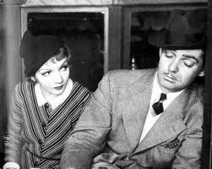
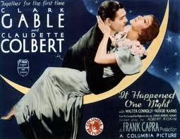
Sklar argues that Capra’s early films "were fantasies of social relationships, his later movies idealizations.” Before 1934, Capra’s films encouraged viewers “to exercise their imaginations, though it constructed a world they could never enter" (205). After 1934, and increasingly as the decade wore on, Capra’s films followed something like the logic of Disney’s imagineering, ("structure all effects so there is no room for the viewer's imagination to operate," 202).
In It Happened One Night (1934), Capra follows a down-on-his-heels reporter on a journey through depression America, escorting a runaway rich girl. Guess what happens.
It Happened One Night (1934) http://www.youtube.com/watch?v=jCqyRmLPI7U

Slide 12
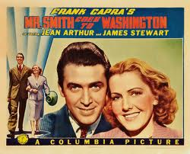
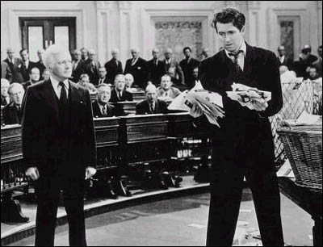
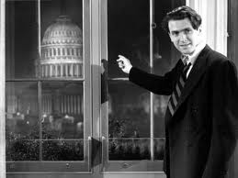
As Capra sought “more socially purposeful effects” (209) and created ever larger and more ambitious models of American society, he created what Sklar calls "an integrated prepackaged network of myths and dreams and invited viewers to join in" (205).
Mr. Smith Goes to Washington (1939) http://www.youtube.com/watch?v=GD-lFCsYOPs http://www.youtube.com/watch?v=s6UbYHCkoZs&feature=related

Slide 13
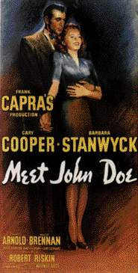
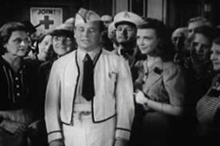
Capra’s films in historical context.
1. The opening of Meet John Doe – classic characters of shyster city from the age of
turbulence, but Capra will redeem them with an injection of small town goodness
2. Capra’s critique of the depression-era fascination with a strong (fascist) leader.
3. But also what’s Capra saying about the people? To borrow from Sandburg, “The People, NO!!!” ?

Slide 14
Baby Face (1933) http://www.youtube.com/watch?v=IwH9yh0vqXs
Duck Soup (1933) http://www.youtube.com/watch?v=oGJkY3o4fNc
Turbulence and order: the PCA and the changing national mood.
Heroes for Sale (1933) http://www.youtube.com/watch?v=Gocdp6Nis5g
It Happened One Night (1934) http://www.youtube.com/watch?v=jCqyRmLPI7U
Our Daily Bread (1934)
Mr. Smith Goes to Washington (1939) http://www.youtube.com/watch?v=GD-lFCsYOPs http://www.youtube.com/watch?v=s6UbYHCkoZs&feature=related

Slide 15
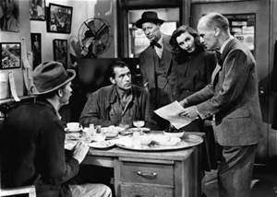
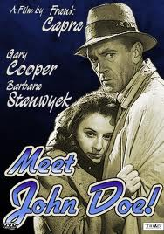
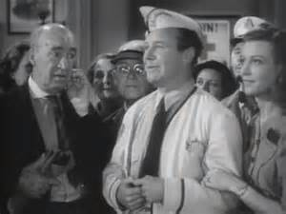
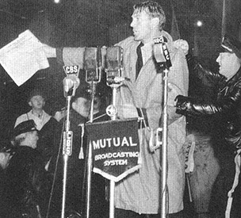
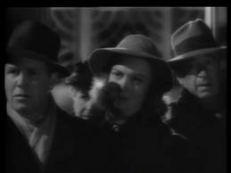
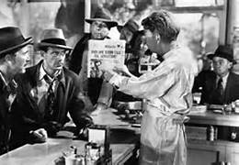
“politics as religion” or “democracy unplugged”?

Slide 16
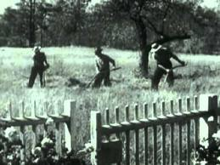
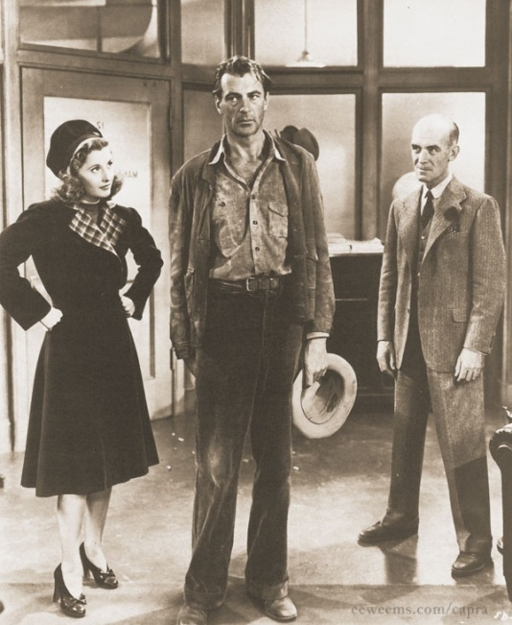



“Did Mumford and Benton [and Capra?] urge a return to a folkish “Golden Day” or naively idealize an industrial capitalist system capable of its own transcendence? Either way, the place of politics and popular mobilization as instruments of social changes remained murky at best.” Casey Blake, “Benton and the Melodrama of Democracy,” Indiana Magazine of History (June 2009), 167-178.
http://www.youtube.com/watch?v=Mg0YQCS9qy8 (four minutes) http://www.youtube.com/watch?v=jd8DpvZVbQg The City (1939) opening two minutes then 7:00-9:45
http://www.youtube.com/watch?v=Mm3GsSWKyso Capra’s use of The City in Why We Fight (28:00-29:00)

Slide 17




Like many muralists, Thomas Hart Benton saw them as “the ‘big parade,’” the “past melting into the present.” But critics dismissed many a Benton mural for its “emotional excess and sentimentality, its heightened theatricality and staginess, its cartoonish portraits of stock heroes and villains painted in garish colors, and its use of simplistic moral dichotomies to tell a historical story.” Could the same be said of Capra’s films?
http://www.youtube.com/watch?v=O4ne13Zft9Q

Slide 18





Literary critic Peter Brooks found the origins of melodrama in the collapse of traditional religion during the French Revolution, in a world, that is, “where the traditional imperatives of truth and ethics have been violently thrown into question, yet where the promulgation of truth and ethics, their instauration as a way of life, is of immediate, daily, political concern.” Not necessarily revolutionary nor conservative, melodrama is always radically democratic, striving to “makes its representations clear and legible to everyone.” It strives for realism but never, as a modernist might, to explore “reality’s” psychological and subjective elements, but only to invoke emotions clinched by formulaic endings.

Slide 19


“Despite his efforts to bring populism into the twentieth century, Benton’s use of melodramatic techniques reveals the waning power of that tradition in a modern, industrial-capitalist society….

Slide 20

“The Indiana Murals cycle culminated in a portrait of Democratic Governor Paul McNutt gesturing toward stock New Deal phrases about ‘State Reorganization’ and ‘Repeal’ - hardly a call-to-arms for a mobilized citizenry.”

Slide 21


Melodrama, it turns out, is where Benton’s (and Capra’s?) “populism went to die.” In the end, all it offered was moral exhortation, without either the asceticism of the prophetic tradition on which it relied or “the mass political mobilization of populist agitation.” It offered only “a formulaic narrative that reaffirms familiar moral conventions by uncovering the hero’s latent moral values and the sheer villainy of his adversaries.” Virtue and truth, it appears, “can be achieved in private individuals and individual heroic acts rather than. . . revolution and change.”
http://www.tcm.com/mediaroom/video/203222/Mr-Deeds-Goes-to-Town-Movie-Clip-Take-the-Stand-.html (intruder/giving away)

Slide 22



“In the melodramatic imagination…the producer radicalism of the late nineteenth century gave way to a stark juxtaposition of the virtuous and the venal.” And the villains will, we are assured, make way. So while Benton failed to translate populism into a modern idiom, “the melodrama of democracy survives in every performance of our nation’s history that demands little of us as citizens.”
The Memorial Day massacre, Chicago, 1937: http://www.youtube.com/watch?v=-Q3RUGLfFv0 2:30-7:30

Slide 23
Philip Evergood, “American Tragedy”

Slide 24



Flint Sit-Down Strikes 1937
http://www.youtube.com/watch?v=8aLUNW4zoPQ3:45-9:40

Slide 25





http://www.criticalpast.com/video/65675068389_Battle-of-the-Overpass_streetcars-at-a-station_police-disperse-marchers_police-chase-men 45 seconds

