Slide 1
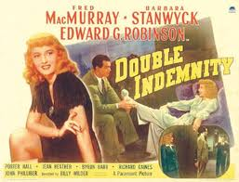
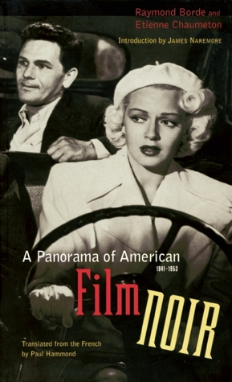
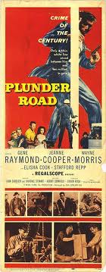
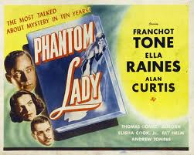
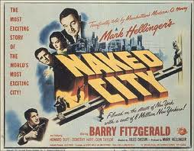
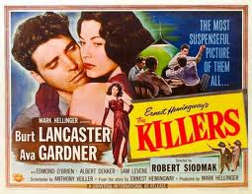
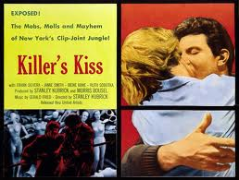
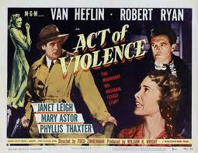
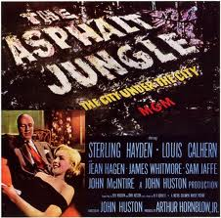

Slide 2
Shadow of a Doubt (1943) DVD
Double Indemnity (1944): netflix
Phantom Lady (1944):
The Killers (1946): DVD
Murder, My Sweet (1944): http://www.tcm.com/mediaroom/video/409934/Murder-My-Sweet-Movie-Clip-You-re-A-Private-Eye.html
The Killers (1946) DVD
The Asphalt Jungle (1950) DVD
Killer’s Kiss (1955): DVD
Plunder Road (1957): http://www.youtube.com/watch?v=yogMuKduGhc
https://www.youtube.com/watch?v=30CC99gQpnU

Slide 3
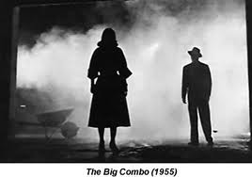
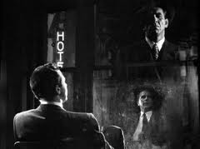
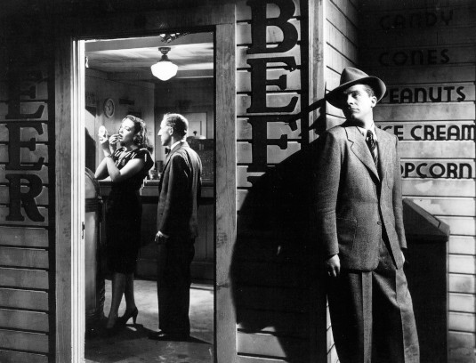
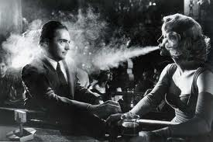
The French and Film Noir

Slide 4
Noir's dark tone, themes, plots:
A) civic and political life as a dead-end, as offering no salvation; whatever salvation one might find is personal
B) the little guy stands no chance in a world where everyone and everything is corrupt.
C) commitment and commitments are for fools; trust no one.
D) we are all prisoners of fate, we are doomed, trapped
E) the disastrous women (the femme fatal); undomesticated sexuality as deadly explosive

Slide 5
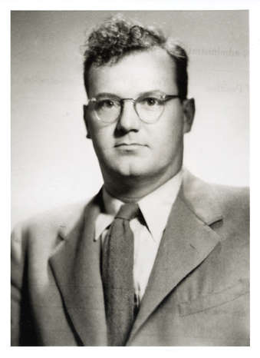
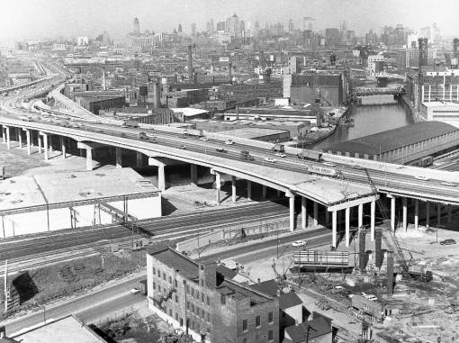
"The forces that are shaping the big city are structural forces. But the awareness and the effective action of 'the citizens' are limited to a scatter of local milieux. That, I think, is a good definition of what is meant by a mass society, and of the city as its major locale. As we become more aware of our condition we come to feel that we are living in a world in which we are merely spectators. We are acted upon, but we do not act. We feel that our personal experience is civically irrelevant, and our political will a minor illusion." C. Wright Mills, "The Big City; Private Troubles, Public Issues," 1959
Manhattantown urban renewal project: http://www.youtube.com/watch?v=mWGwsA1V2r4
Chicago’s SW expressway, 1964

Slide 6
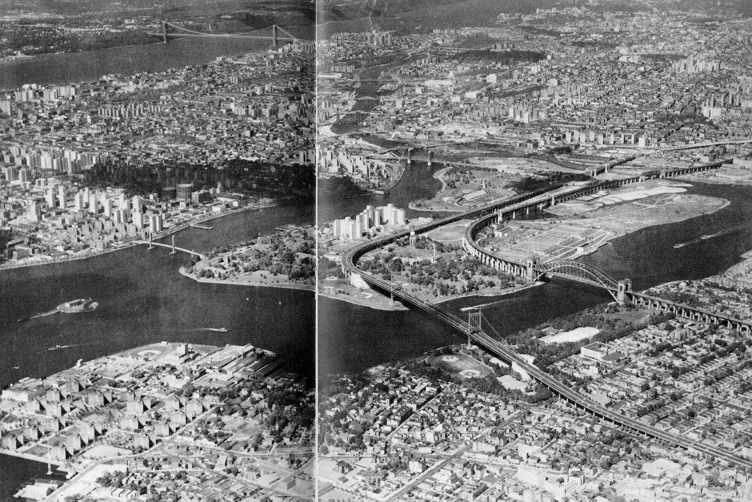
A) civic and political life as a dead-end, as offering no salvation; whatever salvation one might find is personal: A Response to Mass Society: an alien environment; great society, but no great community or great public; a political paralysis felt most acutely at the level of metropolis.

Slide 7
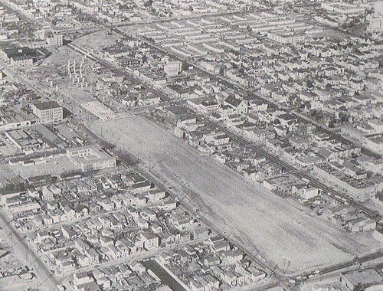
Cypress Parkway, West Oakland, late 1950s
Aerial photography found other practitioners and other uses: the work of Andreas Feininger and Arthur Haug provided the sharp details that would aid postwar planners in remaking and controlling the city. “The photomap, showing as it does every cultural detail, has no substitute where large-scale condemnation and routing problems through metropolitan areas are encountered.” (postwar pamphlet from Fairchild Aerial Photography) Dimendberg, Film Noir and the Spaces of Modernity, 46-47.

Slide 8
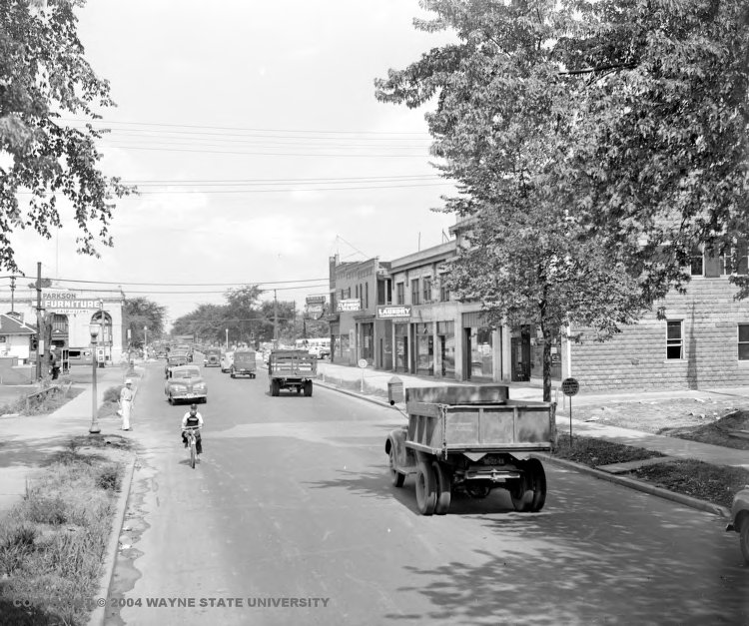
Davidson Avenue, Detroit, 1941

Slide 9
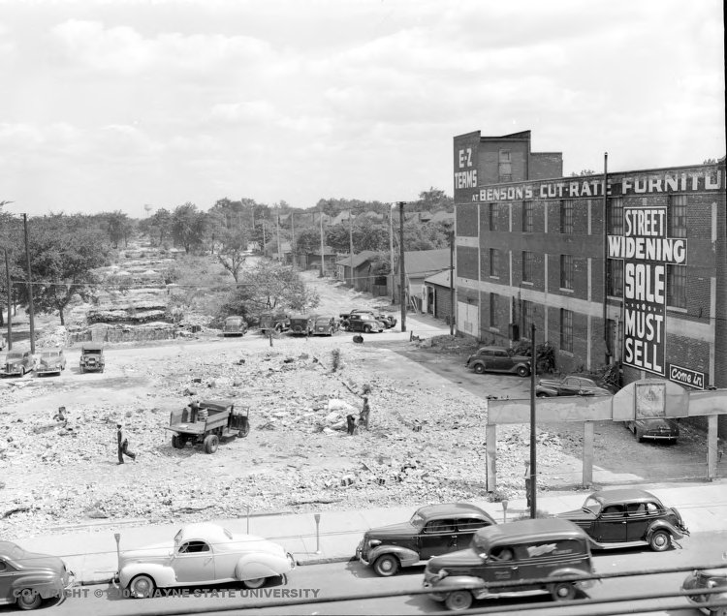

Slide 10
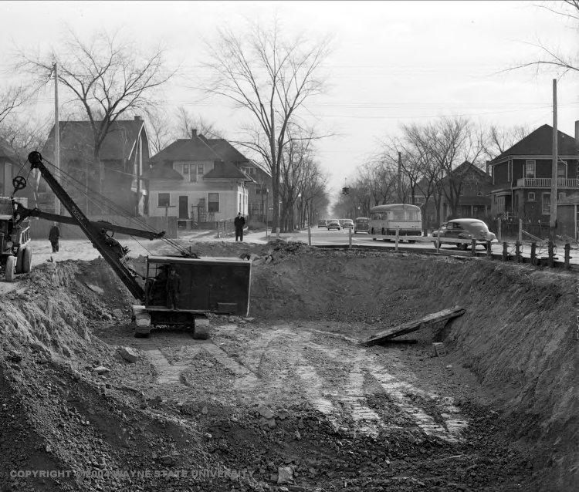

Slide 11
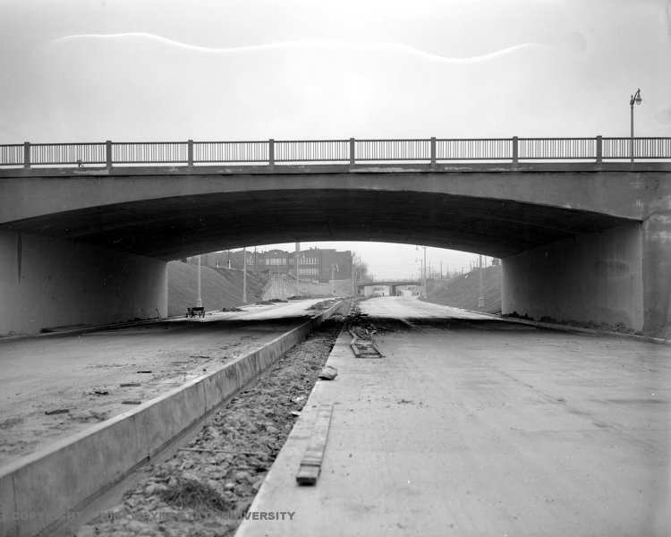

Slide 12
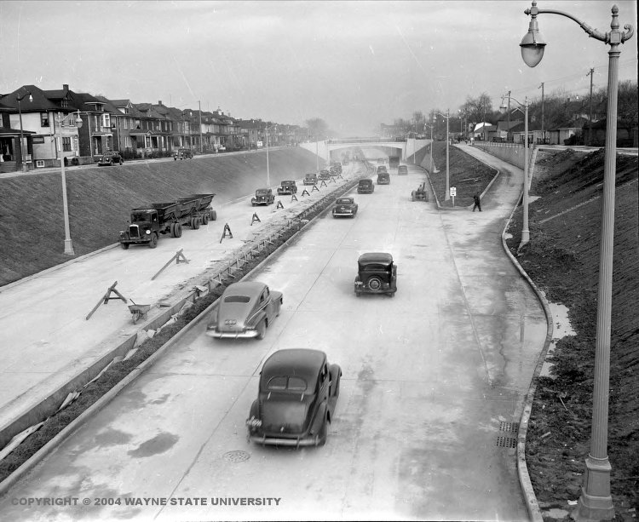

Slide 13
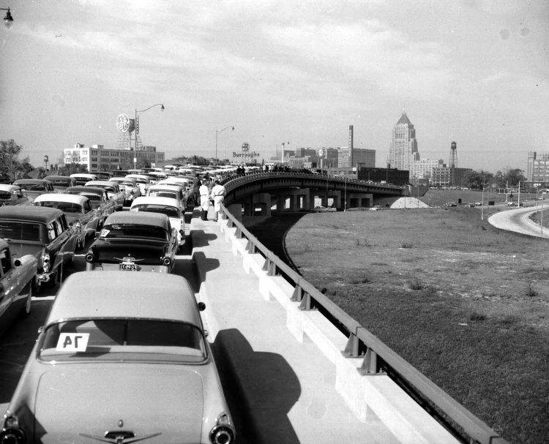
Different expressway, 1955, Detroit

Slide 14
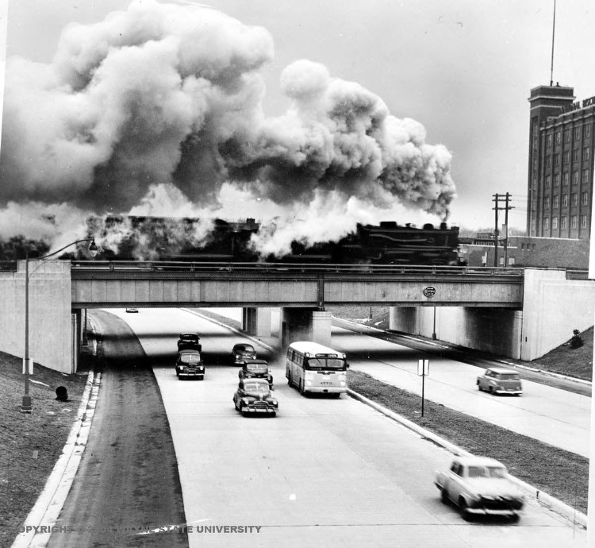

Slide 15
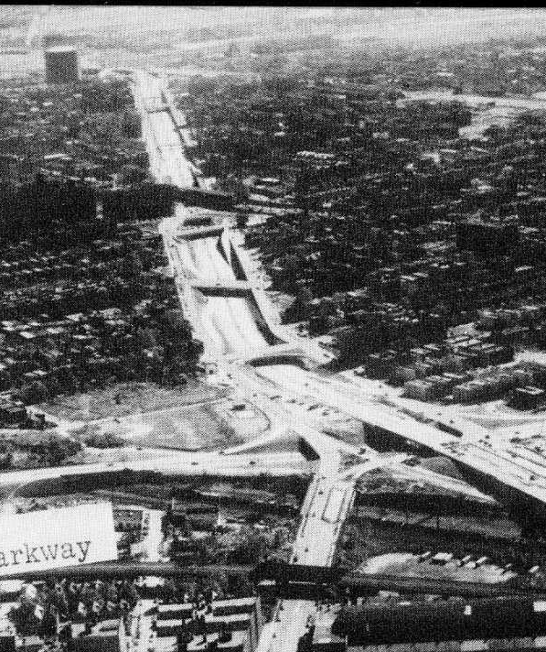
Mass Society: More than one way to have a government-designed program to destroy cities.

Slide 16
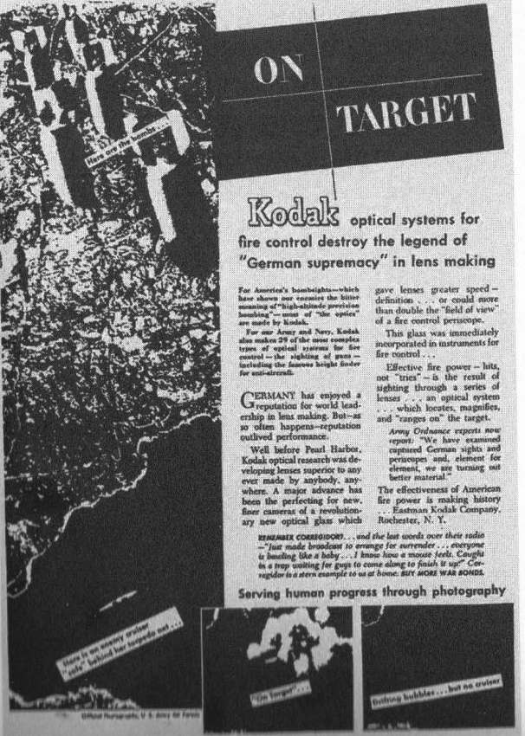
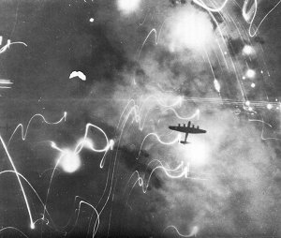
This 1944 Kodak ad captures the role of aerial photography in “strategic bombing” and the destruction of cities around the world. The emphasis on “serving human progress through photography” couldn’t erase the dread many felt with the new vulnerability of cities.

Slide 17
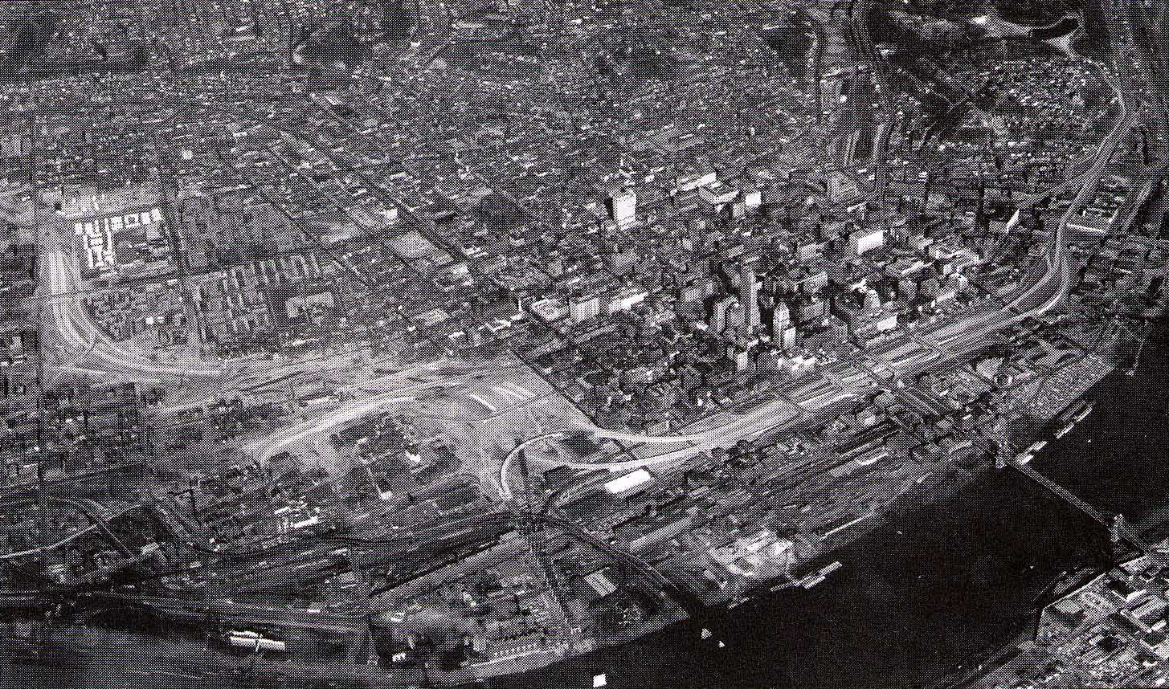
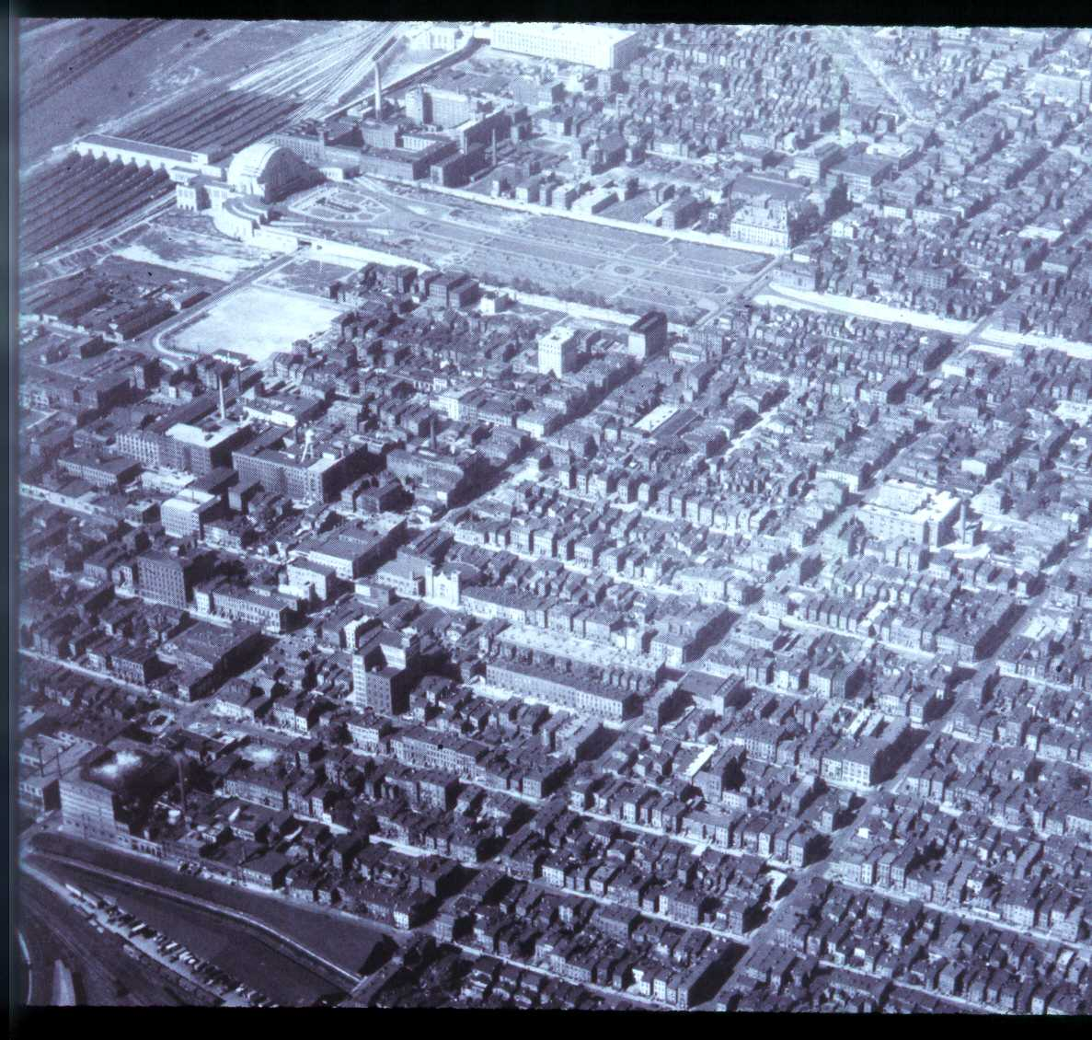
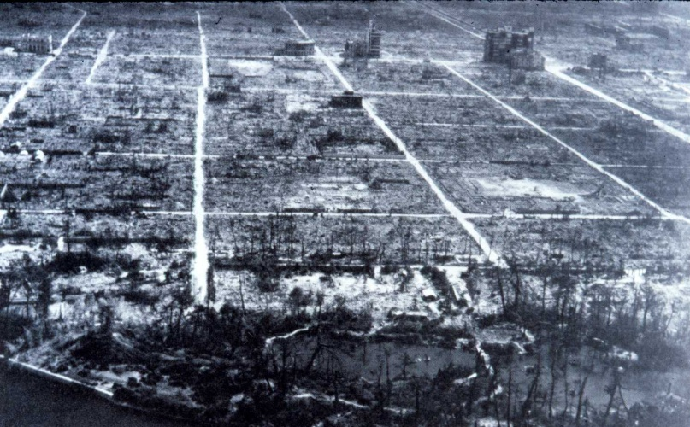
I-75 under construction in the late 1950s, I-71 not yet started.
Residential West End
“Sometimes I think the only solution is to clear out all the people and drop an atomic bomb on that whole slum,” a teacher says out of despair in City Across the River (1949) about gang life in Brooklyn. Sanders, Celluloid City, 167.
Hiroshima

Slide 18
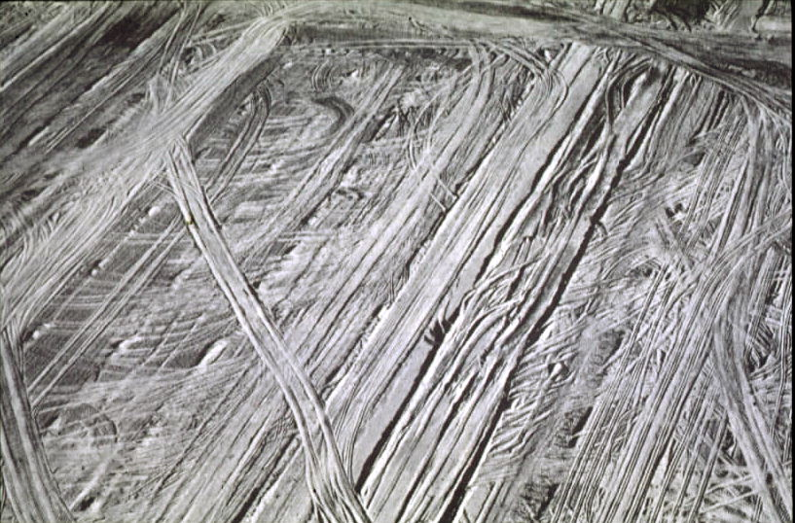
The “promise” of instant community: Lakeview, California, giant subdivision

Slide 19
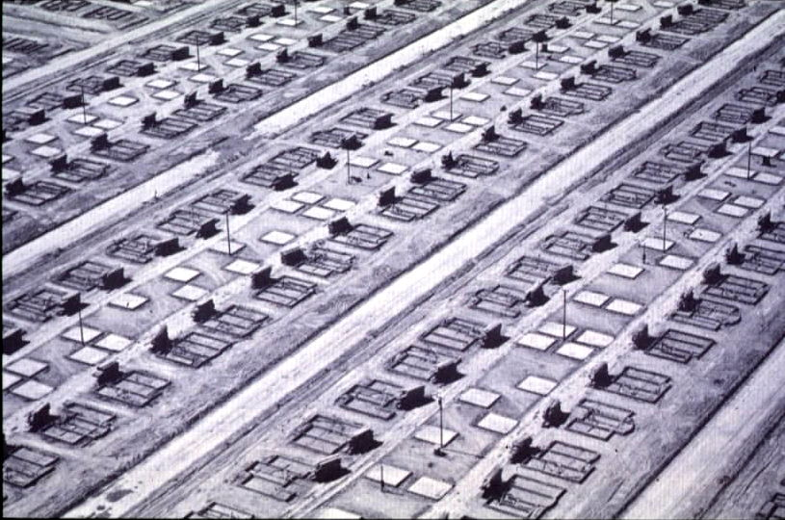

Slide 20
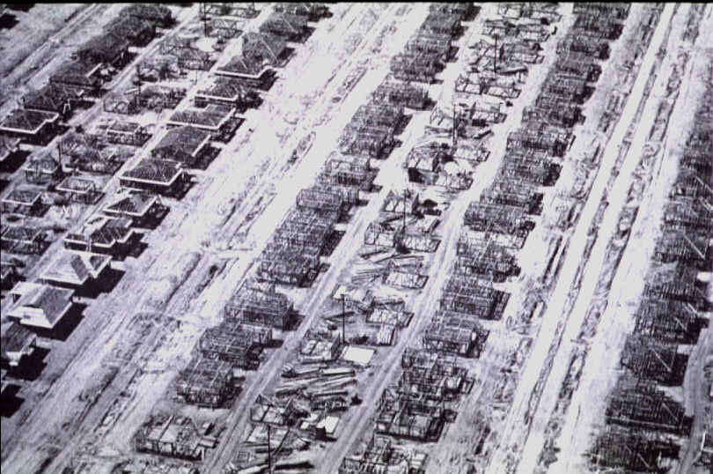

Slide 21
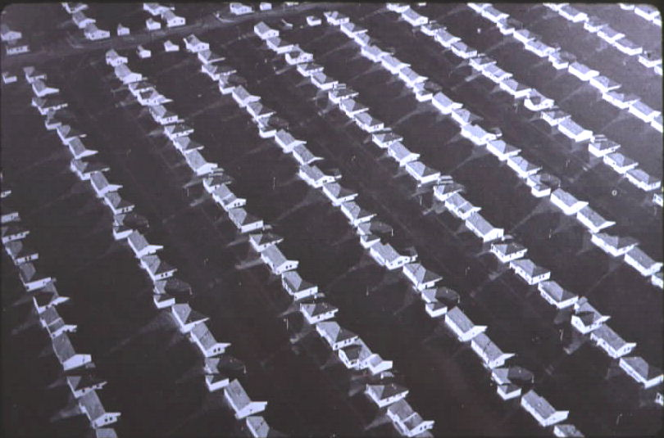

Slide 22
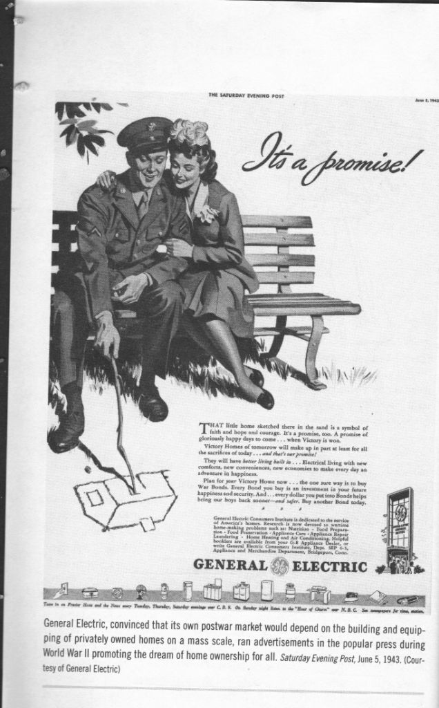
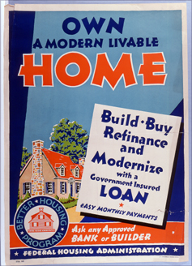
The G.I. would return to his bride and their “victory home,” the ad read, with “better living built in . . .electrical living with new comforts, new conveniences, new economies to make every day an adventure in happiness.”
Electrical corporations lobbied Congress successfully to have built-in appliances and even vacuum cleaners eligible for inclusion on FHA-insured loans.

Slide 23
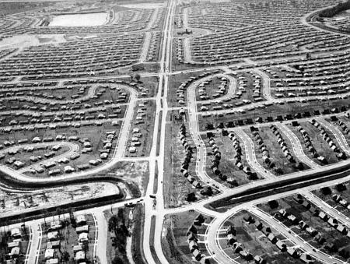
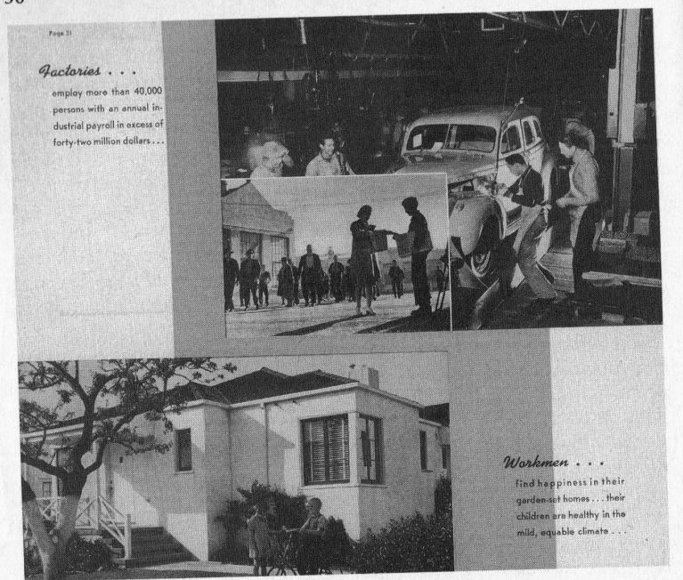
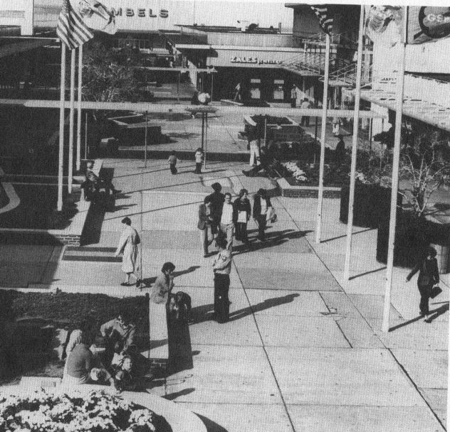
The suburban-industrial complex: FHA mortgages and federal highways supported a variety of realty, financial, construction, industrial, and retail interests dependent on the mass production of suburban housing.
“The movement to the suburbs means more automobiles, more mileage per car and more multiple-car families,” a sales manager observed in 1954. “I leave it to your imagination to think what it means in terms of automotive home workshops, sporting goods, lawnmowers, garden tools, casual goods.”

Slide 24
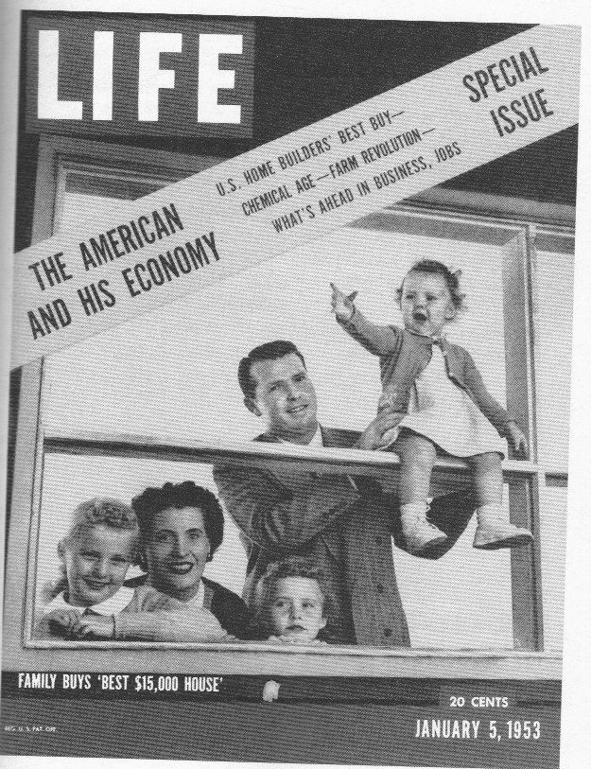
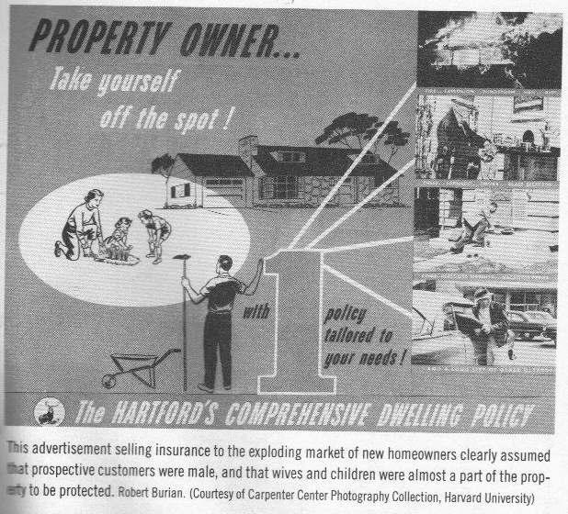
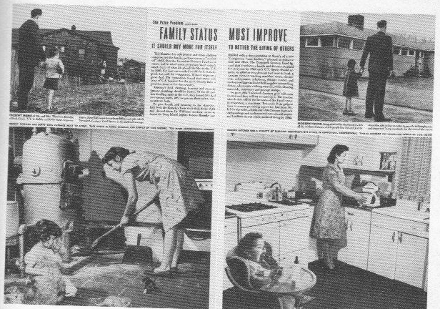
Male bread
winners needed to insure their property which, this ad suggested, included their wives and children.
HIS Economy and HER role in it

Slide 25
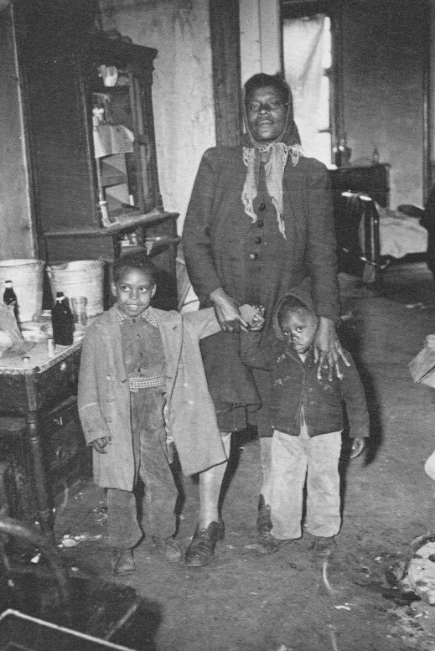
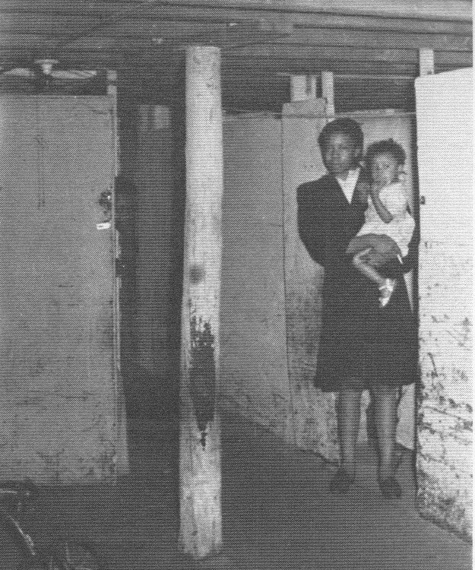
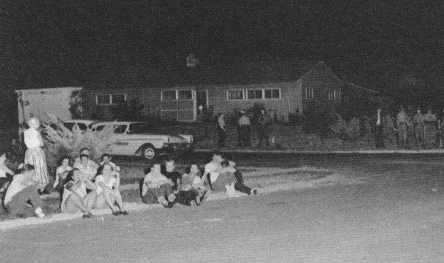
Postwar Segregation
African-Americans in Chicago and other cities crowded into partitioned cellars or squatted in condemned buildings without heat, light, or other utilities
African-Americans who moved into Levittown in Pennsylvania required police protection from angry neighbors.

Slide 26
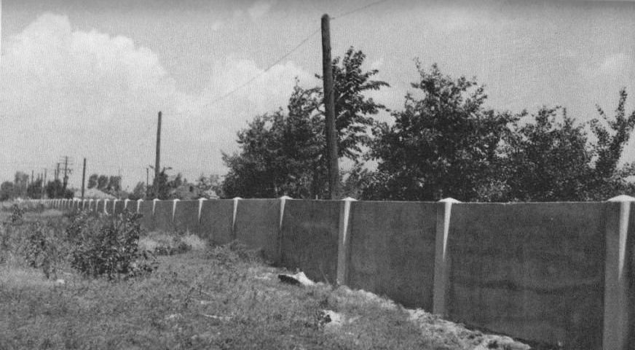
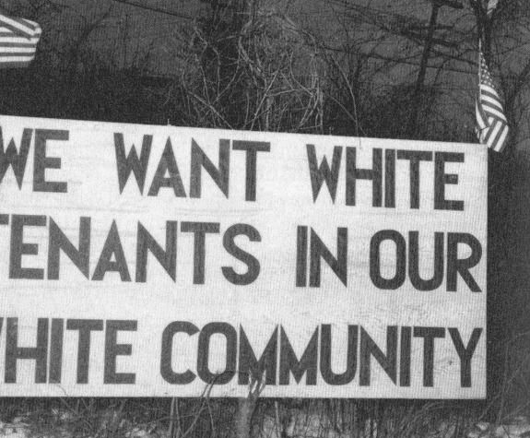
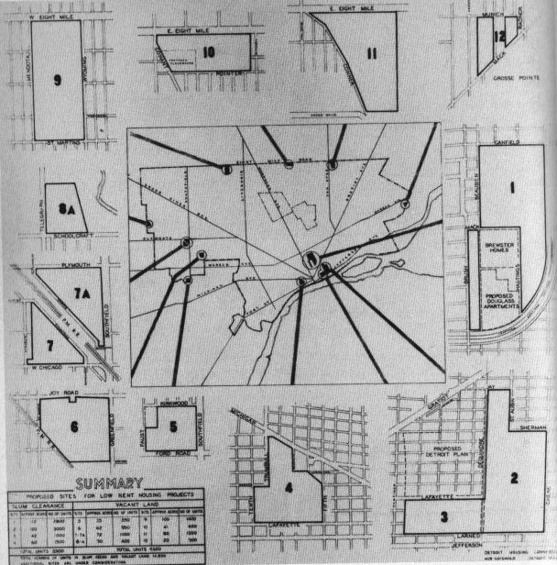
The infamous “wailing wall” dividing black and white neighborhoods in Detroit’s 8 Mile-Wyoming district. A developer erected to wall to secure FHA-support for his whites-only development
Twelve sites for public housing proposed in Detroit during the 1940s. White opposition to outlying sites meant only three inner-city projects were completed.

Slide 27
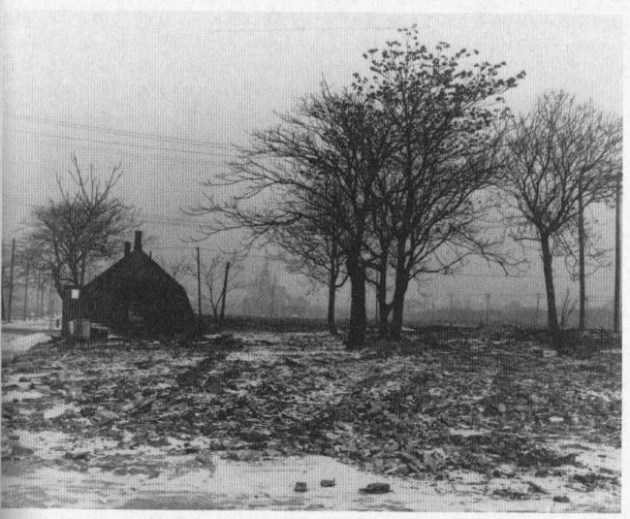
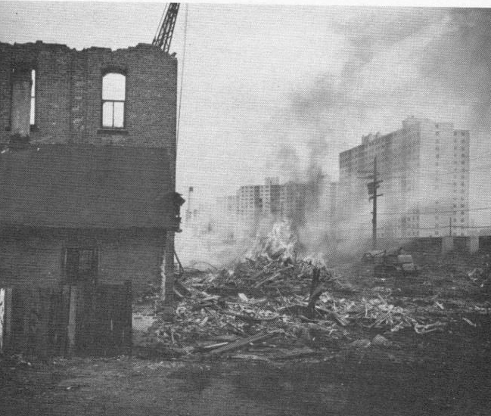


Dispossession:
Urban renewal as negro removal.
Clearance projects in Detroit, Chicago, Oakland

Slide 28


Consider here Hellinger’s opening of Naked City (1948), so similar to a reconnaissance flight for a bombing mission, yet revealing an intact city. So too E. B. White’s This is New York (1949) juxtaposing the emerging United Nations complex with the bombing runs its diplomats would have to try to prevent. White acknowledges urban destruction even as he expressed a (weak) hope for peace. Dimendberg, Film Noir and the Spaces of Modernity, 46-47.

Slide 29
“The Collective Unconscious of the Silent Majority” or “Walking Cures”: Opening a Space for the Interpretation of Film Noir
Question and Three Tentative Answers (below): Did Film Noir play an historical role in shaping the fate of American cities and suburbs? Did it operate as something more than innocent amusement and entertainment? What stories did these films tell about cities and suburbs, what images of cities and suburbs did they popularize? Did these narratives and images support, ignore, or question dominant social trends in the period?

Slide 30
Avila: The Collective Unconscious of the Silent Majority: (City as Labyrinth at the end of the American Urban Century): The economic, political, and social history of postwar suburbanization is well-known, Avila argues. The city came to seem a place of disorder, not only of physical and economic decay but of racial conflicts and confused gender roles. With the aid of federal policies, the white middle class fled the city for the suburbs, where they erected sharp racial boundaries and a new cult of domesticity for women. But white flight, he adds, also required “a new cultural order, one that marked an exchange of the heterogeneous, anonymous, promiscuous spaces of the centralized city for the contained, segregated, homogeneous experiences of the decentralized region.” Film-noir offered the suburbanizing middle class troubling images of the disordered city, just as Disneyland offered them a reassuring model of the good – and ordered – life. In the homogeneous suburban communities of the new conservatism, the contingent and unexpected public disappeared in making way for the perfect, orderly market.

Slide 31




): the boy who cried wolf (opening scene) + the city as prison

Slide 32









FILM NOIR: The City as Labyrinth (or a last loathing and loving look?)

Slide 33
Lounge Time (The Homefront as False Ideal): (Sobchak, “Lounge Time: Postwar Crisis and the Chronotone of Film Noir” the importance of the built environment to understanding noir and the contingent nature of the postwar moment when confused and frightened Americans made momentous decisions.
The “There” There and the Cultural Truth in Film Noir: The Case of the Uncanny Lemonade: What is film noir saying and what significance does it have to lives lived off the screen, Sobchak asks, and answers that whatever it is, “co-here” (coheres) in the material premises, the built environment, of film noir. Thus, like Dimendberg, she is moving from the mythical “city” to specific urban places. And these places, these material premises, will be the antithesis of home. She uses the lemonade scene (and the Swede’s insurance beneficiary – the hotel chambermaid) in The Killers to suggest how utterly alien the home (and homefront, a more or less nostalgic creation of the postwar period) is to film noir, which locates itself more fittingly in seedy hotels and bars, train stations and diners, lounges and roadhouses. The war and the postwar years have a strange relationship to home, seeing the home broken up, depersonalized (taking in boarders, women in the work force), losing its domestic intimacy, simply unavailable (the housing shortage) yet romanticized and longed for nonetheless (with hysterical edge in Mr. Blandings) but more often an indication of emotional wholeness and wellness, however elusive. She sees this in the contrast between city and suburb in Hitchcock’s Shadow of a Doubt and again in the brief, noir transformation of Bedford Falls in Capra’s It’s a Wonderful Life.

Slide 34








In ways that reinforce Dimendberg’s focus on the built environment, Sobchak locates film noir radically and concretely in its visible and concrete places and spaces, places and spaces that exist in both film and specific culture (bound by time and space) and help us connect films to the culture. If film noir is “about” its historical and cultural movement, then it must be rooted in these “material premises,” of cocktail lounge, nightclub, bar, hotel room, boardinghouse, diner, dance hall, roadside café, bus and train station, wayside motel.
“Lounge Time,” p. 137 DVD, Chapter 7-8

Slide 35



A Tree Grows in Brooklyn (1945) I Remember Mama (1948) Noir as counter argument.

Slide 36





“Hey, I like this. Early nothing.” – the Big Heat (1953)

Slide 37



Slide 38




In a startling new interpretation, Edward Dimendberg links film noir to our uneasy transition from an urban to a suburban nation. Reading noir in light of 20th centuries theories of urban life and urban planning, Dimendberg argues that noir privileged what he calls “centripetal” space, the dense, central cities. Noir captures the cultural anxiety about the decay, abandonment, and destruction of these spaces, as well as the dynamics – good and bad – of such spaces. At the same time, and increasingly as the noir cycle moved toward its end in the mid 1950s, noir explore anxieties associated with centrifugal space, the new, decentralized spaces of the highway, suburbanized metropolis.

Slide 39





But then again is/was film noir civically useless, simply about surrender in the face of this destruction?

Slide 40
These films give us unique access to the spaces of the 1940s and 1950s and offers lessons about those spaces for us in the present. Other commentators have, of course, linked the city to film noir, but more as an underlying mythic structure, theme, or vision. But Dimendberg added a new emphasis on geography, city planning, and architectural theory, as well as urban and cultural theory. He is examining “the city” in film noir, but specifically the historical, changing postwar city in film noir. He urges us to recognize the destructive power of postwar planning and redevelopment, akin to the destruction of war, and to see film noir as an aid-to-memory to a society losing the physical basis of its memories (and experiencing loss and displacement as a result). For us, reexamining film noir should sharpen our sense of historical difference, of how different that era was to our own, and to heighten our sense of our own period as “merely one outcome among many contingent possibilities.”

Slide 41








Slide 42
Double Indemnity: We first see Neff spending through the streets, nearly hitting the maintenance workers on the deteriorating LA streetcar system. We see relatively little of the city and what we see are discontented spatial nodes, or rather a few discreet places connected only by speeding automobiles. The film comments often on technological determinism, murder “straight down the line” and the conspirators as streetcar passengers forced “to the end of the line.” The Pacific All-Risk office building is just one element in “a rational and expedient mechanism” that orders the lives of the metropolitan population (corporations, highways, automobiles). This rational and expedient mechanism puts speed, flow, and mechanized, individual communication and transportation (automobile, telephone, tv) first. Cities increasingly lack central spaces that bring together diverse groups, even lack traditional architectural elements and focus on highways and flows of invisible communications.

Slide 43







Slide 44
Act of Violence: “Too often we forget that the suburb has been built at a terrifying cost,” a popular study of the city observed in 1955, particularly in “the abandonment of the city, the center of our civilization.” Giving the city a last, long, loving and loathing look, and exploring the rootlessness of its inhabitants, who clung uneasily to the seedy commercialism of the disappearing city or tried to enter, even more uneasily, into the new suburban order, noir called attention to this momentous decision, inviting us to reconsider it.

Slide 45







Slide 46
Several films noir hinge on the twin urban skills of noticing others and disregarding others, skills dramatized in the opening scene of bodies crushed in centripetal space (the subway) in Pickup on South Street. Disregard allows the pickpocket to steal a wallet, but the knowledge that urban anonymity provides a rich milieu for crime also gave rise to strategies of surveillance represented by the cop and the FBI man on the subway. Simmel spoke to the anonymity of urban life, the indifference to strangers, but a vast literature also focused on identifying the threatening from the benign stranger. These techniques of surveillance, of classifying and locating bodies in the urban realm, culminates in the anthropomorphizing of the city itself, the naked city subjected to technological scrutiny and surgical planning (think panorama). The trope (i.e. a figure of speech or cliche) of “the naked city” explores the growing sense of vulnerability, isolation, and exposure people felt in post-war cities.
http://www.tcm.com/mediaroom/video/218135/Naked-City-The-Movie-Clip-Story-of-the-City.html
http://www.youtube.com/watch?v=cUO-tnJWhas

Slide 47









Slide 48
The Naked City: Weegee’s and Hellinger’s naked cities shared this: “their role as urban narrators whose humanizing discourse imposes order on the random and often chaotic experience of the metropolis” (57). Both posed as reassuring and sincere authorities, Hellinger as a columnist telling stories similar to Weegee’s photographs. Building on wartime location photography, posing as the voice of the city, basing the story on actual police procedures, Hellinger follows the aerial opening with a montage similar to Ruttmann’s in Berlin - only it’s the city asleep, not at dawn, and less centered and connected. Indeed these empty sites, captured in the early morning hours, suggest Sartre’s idea of seriality: “cultural production directed simultaneously toward everyone and no one” in a mass society (best captured in the top ten best-selling record shows, where you get a picture of what the ideal, mass-oriented “other” would like and listen to - a record collection which is no one’s and everyone’s at once). This is a vision of the city as isolation, buying the same paper everyone else buys then reading it on the bus while ignoring everyone else. The spoken and written word – and mass produced images - took the place of architecture and urban space in shaping collective meaning and community. The Naked City, as film and TV show, outlasted the spaces and places (Turtle Bay, the Third Avenue elevated) it photographed. In its publicity, The Naked City established new social groups, to counter the alienation it depicted, by setting up photo contests and competitions for a “voice of the city.”

Slide 49



Slide 50

http://www.youtube.com/watch?v=sPuoplSAeFE

Slide 51

A startlingly coherent neighborhood in sprawling, suburban Los Angeles, Bunker Hill began as an elite residence in the 1880s and 90s and slid into slum-status after World War I. Raymond Chandler made it famous as “crook town,” a place with double the crime rate of the rest of the city. Targeted for urban renewal in 1945 and swept up into the urban renewal schemes that followed the Housing Act of 1949, it had disappeared by the end of the ‘60s. It remains a politically-charged memory. Developers had long wanted to flatten its hill and build new condos but others saw the obstacle to traffic and the elevation as assets and called for rehabilitation rather than destruction. Once slated for low-income housing, Bunker Hill caught the eye of the “Committee Against Socialist Housing” which wrote a commercial redevelopment plan in 1959.

Slide 52

Bunker Hill cheap lodgings and movie sets: http://archive.org/details/ADriveThroughBunkerHillAndDowntownLosAngelesCa.1940s
http://silentlocations.wordpress.com/2011/09/09/stan-ollie-and-harold-a-drive-through-bunker-hill/

Slide 53

Today the top of the hill has been leveled.

Slide 54




In his classic 1984 article, "The Cultural Logic of Late Capitalism," Jameson had breathlessly described L.A.'s Hotel Bonaventure as the archetypal postmodern structure. Its multiple entryways, elevated gardens, and glass mirrored surfaces formed a delirious "hyperspace," inciting those who entered it to "expand our sensorium." While noting in passing that the hotel's glass skin "repels the city outside," Jameson breezily praised the hotel as "a popular building, visited with enthusiasm by locals and tourists alike."

Slide 55



Davis's response was unsparing: "To speak of its 'popular' character is to miss the point of its systematic segregation from the great Hispanic-Asian city outside," he thundered in NLR (where Jameson's essay had also appeared). Cutting through Jameson's theoretical haze, Davis emphasized the "smog-poisoned reality" outside and described the hotel as part of an ominous trend of "large vivariums for the upper middle classes, protected by astonishingly complex security systems."

Slide 56




Kiss Me Deadly (1955) offered a coherent and attractive view of Bunker Hill, juxtaposing its pedestrian scale and street life to the homogenized and traffic-choked spaces of suburban LA.
Hammer’s drive beneath the Angels Flight funicular – the “shortest railway in the world” – suggests how the automobile and the Harbor freeway impinged on and doomed Bunker Hill.
http://www.youtube.com/watch?v=Jqc50ySFqIs

Slide 57




Bunker Hill and mass media: opening seconds
Tenements and TV and decay of walking city: 7:20-10:00
http://www.youtube.com/watch?v=NiEg7ZH8vcE

Slide 58
Losey’s 1951 remake of M highlights the role of TV in bringing the news to centrifugal Los Angeles – a precursor of the TV event like OJ’s car ride. But the film also centers on Bunker Hill, a centripetal survival in the suburbanizing metropolis where radio-controlled taxis join in the hunt for a child-murderer. The gaze out the windshield of the taxi drivers captures LA’s abstract, centrifugal spaces and is played off the arcade-like architecture of the 1893 Bradbury building (wrought-iron decoration, glass skylight, central courtyard) – an older vision of modernity, now antiquated and suggesting the demise of pedestrian-based urbanism and public space (particularly as underworld figures invade the building, smashing windows in search of the murderer). The film also subtly plays off (and offers a critique of) the media event of HUAC’s public hearings in Washington that went forward while the film was being made (several people who worked on the film had been subjects of the witch hunt).

Slide 59



http://www.youtube.com/watch?v=yogMuKduGhc

Slide 60
In a process profoundly reinforced by the accumulation of filmed images, history had become “polyrhythmic and multi-spacial,” no longer moving along a linear path. Film noir captures that, invoking the past (in disappearing urban space) and invoking the future (in a new road-oriented world). Noir explores the tension between “a residual American culture and urbanism” and “its liquidation by the technological and social innovations” of the post-1945 period. The end of the noir cycle is signaled by the (relative) disappearance of centripetal urban spaces and a focus on centrifugal spaces and the means of surveillance in such spaces as well as the media simultaneity (M’s radio controlled taxis or, here, the traffic report to a dispersed and mobile audience).

Slide 61

Fragmentation and Contingency Kracauer, in arguing with Proust, sees photographic images not as mirrors perfectly capturing an objective reality, but as subjective: photographers “structure their sense perceptions” and viewers “bring a range of emotions” to the images (132). If done properly, however, Kracauer believes film “strips away our desires and unconscious attachments to reveal characteristics of the visible world” (133), overcoming our usual blindness to the actual physical characteristics of things. This shock to our perceptions leaves us fragmented – instead of the sense of mastery we get from panoramic views, we recognize “contingency, lack of control, and otherness. . . an aesthetic experience on par with the historical crisis of experience” (Hansen’s words, 133). This is Nino Frank’s lived experience again, “a wound that never heals” whereby physical reality punctures of subjective of it. “Film renders visible what we did not, or perhaps even could not, see before its advent” and thus it can “promote the redemption of physical reality.” Hoping to “renew our perceptions” and “redeem experience,” Kracauer compares the spectator to the flaneur in being drawn to the flux, the contingency, the possibilities of the crowd, the city, the passing scene. The film goer at some point even loses concern with the story and is drawn to the images of mingling, the opportunity of drama. Dimendberg then locates Kracauer’s transhistorical discussion in a specific place and time: read 135, bottom: His spectator is the American occupant of the postwar city, an occupant of abstract space being shocked into seeing the disappearing contours and landmarks, streets, stations, bars. Killers’ Kiss (1955) not only shows such disappearing spaces (Penn Station) but shows that chance encounters is as much the driving force of film noir as is fate and inevitability.
Pedestrians, walking cures, chance and contingency: 37:00-
And Killer’s Kiss (1955): nightmare

Slide 62






http://www.youtube.com/watch?v=7ARFH6LPRh4 “strange attraction” 6:45

Slide 63
The discussion of The Phantom Lady then links the “generalized look” and the “contingent instance” to the “incessant struggle between perceptual indifference and engaged cognition, forgetfulness and remembrance” (31). Ann Terry’s hat suggests both sides - the hat standing in for the person (a generalized indifference to classifiable individuals), but the hat also being the trace, the clue that can lead to recognition and remembrance. Building on the first, the indifference, the use of mirrors and gazes and anonymity underscores the transitory and empty nature of many urban encounters and “entrapment in socially defined identities” (35). Building on the second, the engaged cognition (when Richmond and the cops interrogate strangers to try to solve the mystery) brings forth a fear of the “naked city,” exposed to surveillance, without walls, substance, refuge, cover. The film’s references to the coming modernist city - all glass-walled skyscrapers and model suburbs of open spaces and sunlight - expose all to surveillance and gives rise to film noir’s desire for “a space that is neither too insubstantial nor too constricting, neither too anonymous nor too visible” (36).

Slide 64



A Noir? Why or why not?

Slide 65


What sort of place is this courtyard? What sort of person is Jeffries?
Rear Window (1954): trailer + the film’s “noir” moment or chapter 13 on “rear window ethics” (6:20)

Slide 66

The sights and sounds of the city: (note the soundtrack of this film). The cityscape: no less than 31 apartments are used in the film. It required the largest set even built on the Paramount lot (and this is where Cecil B. DeMille worked!!!). 125 West 9th Street (it doesn’t exist - of course!!), replete with 8 apartment interiors, fire escapes, gardens, an alley, the street itself and, in the background, the New York City skyline. The set was 98 feet wide, 185 feet long and 40 feet high. The background structures rose to 6 stories. Aside from everything else, there is a silent film within the sound film as the neighbors all acted in pantomime as he directed them from headsets.

Slide 67



Rear Window, ch. 15 Lisa’s Risk: (7 minutes but key is four minutes in)

Slide 68




Contrast Plunder Road with And This is Free: http://vimeo.com/33013238

Slide 69




B. the little guy stands no chance in a world where everyone and everything is corrupt. The decline of the petty proprietor (noir’s literary sources). Beginning in 1934, with James M. Cain's The Postman Always Rings Twice, a succession of through-the-glass-darkly novels - all produced by writers under contract to the studio system - repainted the image of Los Angeles as a deracinated urban hell." - Mike Davis, City of Quartz (1990)
A closer took at mass society: Is the rise of mass society as much the absence of responsible citizens as it is the complexity of the problems we face?

Slide 70





Screen Writers as Petty Proprietors
Budd Schulberg, author of What Makes Sammy Run? (1941) and one-time member of the Communist party who cooperated with HUAC. (Sammy was a movie executive and the single-minded answer was “money”)
Double Indemnity (1944) can be read as Chandler and Wilder’s disgust with corporate culture.

Slide 71

http://www.netflix.com/WiPlayer?movieid=60030178&trkid=222336&strkid=1791728359_0_0&strackid=68bf07eb5fcc43fc_0_srl&fdvd=true 1:01-1:03:30, 1:06:10-1:08:20 (five minutes)

Slide 72



"Sociologically, 1940s noir was more typically concerned with gangster underclasses and official corruption than with the pathology of the middle class; politically, the implicit obsession with the fate of the petty producer was supplanted by representations of political reaction and social polarization." - Davis, City of Quartz. So compare the criminals of the gangster cycle of films to the criminal in a noir classic, Dead Reckoning (1947)

Slide 73


Or consider the “confidential” series of “B” noirs in the early 1950s – the raunchiest and most despairing of noirs (and their reappearance in the 1990s).

Slide 74


Slide 75


Slide 76


C.) commitment and commitments are for fools; trust no one: the COLD WAR and conspiracy and corruption as a means of understanding mass society. "We will not knowingly employ a Communist or a member of any party or group which advocates the overthrow of the Government of the United States by force, or by any illegal or unconstitutional method....We are frank to recognize that such a policy involves dangers and risks. There is the danger of hurting innocent people, there is the risk of creating an atmosphere of fear. Creative work at its best cannot be carried on in an atmosphere of fear." - committee of motion picture producers on the day HUAC's contempt citations for the ten "unfriendly witnesses" was upheld by the entire House, November 24, 1947

Slide 77





A Frightened Public: Conflict and Containment
You must “scare the hell out of the American people.” - Sen. Arthur Vandenberg (R-Michigan) to President Truman
From uneasy allies to paranoid enemies

Slide 78






Why disloyalty? Think about secrecy and conformity
“A Conspiracy So Vast”: Loyalty Under Fire
8 March 1954
Convicted of perjury in 1950 Hiss spent 44 months in jail.

Slide 79

D. we are all prisoners of fate, we are doomed, trapped: The City as Trap: Hiroshima: Mass society in its most uncontrollable and violent form.

Slide 80
“Too often we forget that the suburb has been built at a terrifying cost,” a popular study of the city observed in 1955, particularly in “the abandonment of the city, the center of our civilization.” Giving the city a last, long, loving and loathing look, and exploring the rootlessness of its inhabitants, who clung uneasily to the seedy commercialism of the disappearing city or tried to enter, even more uneasily, into the new suburban order, noir called attention to this momentous decision, inviting us to reconsider it.

Slide 81




Film noir conveys “impression of real life, of lived experience” (Nino Frank via Dimendberg) that differentiated it from detective films of the past. The narrative device reinforced that, producing a fragmented story with rapid transitions that gave “a greater impression of lived experience.” Not simply a quest for realism, the emphasis on lived experience captures a concern with “temporality and spatiality” that addresses both the concentrated urban space of the 1940s metropolis and the dispersed and fragmented spaces of the suburban world. The continuing fascination with film noir registers a nostalgia for a cinematic and urban experience, an experience of time and space, an image of the city, that theme parks and yuppie lifestyle enclaves cannot provide.

Slide 82





Two clips here, first illustrating the labyrinth. But second suggesting how, as early as 1947, centrifugal space, and the movement between city and country, became more pronounced.

Slide 83





"These depression-crazed middle classes [from EPIC to Ham and Eggs fascism] of Southern California became, in one mode or another, the original protagonists of that great anti-myth usually known as noir. - Mike Davis, City of Quartz (1990)

Slide 84




http://lyngoldfarbproductions.com/portfolio/the-great-depression

Slide 85


http://www.youtube.com/watch?v=tPQfLqnsLEg

Slide 86




"Let's stay away from politics
Regardless of who hollers
Let's not be fooled by childish tricks
LET'S GET OUR THIRTY DOLLARS"
http://news.google.com/newspapers?nid=1144&dat=19401106&id=9o4cAAAAIBAJ&sjid=i44EAAAAIBAJ&pg=2254,5229545
Ham and eggs began as a derisive reference to the pension plan but the movement picked it up and the call and response of ham and eggs reminded some critics of seig heil. The movement did have anti-semitic, pro-Nazi, and dictatorial, and elements. I wonder if Capra had it in mind in Meet John Doe.

Slide 87


Slide 88



Japanese invasion of Manchuria, 1931, then China proper 1937

Slide 89



Guernica, 1937

Slide 90


Old Market Square Warsaw

Slide 91

Rotterdam: “Schrecklichkeit” (frightfulness), bombing designed to terrorize civilian populations

Slide 92


Slide 93


Slide 94

Dutch civilians

Slide 95

London Blitz over St. Paul’s and from the air

Slide 96


Coventry Cathedral, England

Slide 97
London Blitz - during the blitz Churchill called for “exterminating” air attacks on German cities.

Slide 98

Leningrad Siege
Hitler’s plan was to weaken
the city “by terror
and growing starvation,”
then “remove the survivors
in captivity in the
interior of Russia,
[and] level Leningrad to
the ground with high
explosives.”

Slide 99

Siege of Leningrad:

Slide 100

Nazi General Franz Halder wrote that annihilating Moscow would create a “national catastrophe which [would] deprive not only Bolshevism but also Muscovite nationalism of their center.” Although Hitler initially proposed to spare “St. Petersburg” because it was “incomparably more beautiful” than Moscow, he soon added Leningrad to the list. The site of Moscow was to be replaced with a giant reservoir. Something of the sort actually happened at Stalingrad, where Russian reinforcements crossing the Volga were greeted with this image of hell.

Slide 101


Slide 102


Slide 103


Royal Palace, Budapest
built in the 18th century

Slide 104

American 7th Army
Advances Through
Waldenberg
As early as 1942,
British “area” bombing
(which replaced the
infamously imprecise
“precision” bombing
and which could be
carried out during the
day) had demonstrated
that whole cities
(Lubeck and Cologne)
would be annihilated
with one or a few raids.

Slide 105

Bremen and Schweinfurt
A Government-planned assault on cities: “The Chemical Warfare Service was up to the task [of designing reliable incendiaries]. Model enemy towns were constructed as proving grounds in the United States, the effort at authenticity measured by the employment of German Jewish architects to design the German towns and by the attention to detail down to ‘the curtains, children’s toys, and clothing hanging in the closets.’” - Michael S. Sherry, “The Bomb as a Technology of Death,” 1987

Slide 106


In the British bombing of Hamburg in 1943, the explicit “Intention” was “to destroy HAMBURG.” Most Secret Operation Order No.173, May 27, 1943, estimated that 10,000 tons of bombs would
“complete the process of elimination.”

Slide 107


Allied Fire Bombing of Dresden, 100,000 killed

Slide 108


Mannheim, Germany
Nuremburg, Germany

Slide 109

Ruins of a great newspaper building, Berlin 1945 - street had just
recently been cleared of rubble

Slide 110

Berlin, fall 1945

Slide 111

Tokyo March 1945
The “central purpose of
the terrible fire bomb
raids on Tokyo was not
so much to destroy
Japanese fighting
capability as to weaken
the will of the people
and government to
continue the war.”
Martin J. Sherwin, 1973

Slide 112


Incendiary bombing “may be the golden opportunity of strategic bombardment in this war - and possibly one of the outstanding opportunities in all history to do the greatest damage…for a minimum of effort….However, the dry economic statistics, impressive as they may be, still do not take into account of the further and unpredictable effect on the Japanese war effort of a national catastrophe of such magnitude - entirely unprecedented in history.” Office of Scientific
Research and Development.
“It is certainly a good thing for the world that Hitler’s crowd or Stalin’s did not discover this atomic bomb.” President Truman, July 15, 1945

Slide 113

"For all we know, we have Created a Frankenstein! We must assume that with the passage of only a little time, an improved form of the new weapon we use today can be turned against us." H.V. Kaltenborn, NBC radio, on the day of the Hiroshima bomb

Slide 114


Hiroshima: "Seldom, if ever, has a war ended leaving the victors with such a sense of uncertainty and fear, with such a realization that the future is obscure and that survival is not assured." Edward R. Murrow, CBS radio, August 12, 1945
From Life’s “36 Hour War, November 19, 1945

Slide 115

Antwerp V-1 Rocket Attack (see Thomas Pynchon, Gravity’s Rainbow)
“When they start dropping those bombs”
http://www.youtube.com/watch?v=pF87-4teb-c 33:00-35:30, 41:00-41:45

Slide 116

E. The Femme Fatale: Postwar domesticty (“ah, the escape from mass society”): The nuclear family and the terrors/threat of the age: thermonuclear war, male angst and alienation, female sexuality and emancipation, perversion and subversion and the crisis in masculinity, and the irony of McCarthyite fears (materialism, bureaucracy, conformity)
The suburban ranch-style home (c. 1950) offered a sheltered look of protected privacy and a surrounding natural world reassuringly tamed and controlled.

Slide 117



Slide 118



Slide 119


Bombshells, bikinis, and undomesticated sexuality as a dangerous, explosive force.

Slide 120

E. AH, DOMESTICITY, the ESCAPE from mass society.
The ex-serviceman must become "the head man again....Your part in the remaking of this man is to fit his home to him, understanding why he wants it this way, forgetting your own preferences." - House Beautiful, 1945

Slide 121

"Women who lead very active lives, under conditions of nervous stress and strain, often do not conceive, and when they do, they miscarry. These women are violating their own biological natures; and for this they pay a heavy price."
- Ladies Home Journal 1949

Slide 122

Disciplining Women
A 1958 department store window depicting the ideal suburban family.
It instructs women consumers “How to Keep a Man” - by buying home
movie cameras and backyard barbecues.

Slide 123




Slide 125
But then again is/was film noir civically useless, simply about surrender in the face of this destruction?

Slide 126
These films give us unique access to the spaces of the 1940s and 1950s and offers lessons about those spaces for us in the present. Other commentators have, of course, linked the city to film noir, but more as an underlying mythic structure, theme, or vision. But Dimendberg added a new emphasis on geography, city planning, and architectural theory, as well as urban and cultural theory. He is examining “the city” in film noir, but specifically the historical, changing postwar city in film noir. He urges us to recognize the destructive power of postwar planning and redevelopment, akin to the destruction of war, and to see film noir as an aid-to-memory to a society losing the physical basis of its memories (and experiencing loss and displacement as a result). For us, reexamining film noir should sharpen our sense of historical difference, of how different that era was to our own, and to heighten our sense of our own period as “merely one outcome among many contingent possibilities.”

Slide 127
Film noir conveys “impression of real life, of lived experience” (Nino Frank via Dimendberg) that differentiated it from detective films of the past. The narrative device reinforced that, producing a fragmented story with rapid transitions that gave “a greater impression of lived experience.” Not simply a quest for realism, the emphasis on lived experience captures a concern with “temporality and spatiality” that addresses both the concentrated urban space of the 1940s metropolis and the dispersed and fragmented spaces of the suburban world. The continuing fascination with film noir registers a nostalgia for a cinematic and urban experience, an experience of time and space, an image of the city, that theme parks and yuppie lifestyle enclaves cannot provide.
http://www.tcm.com/mediaroom/video/349098/Act-Of-Violence-Movie-Clip-No-Place-To-Go.html
http://www.youtube.com/watch?v=Jqc50ySFqIs

Slide 128


No longer a nightmare of spatial segregation and class-bound privilege (Lang’s Metropolis), the city threatened to become “a homogenized and homogenizing abstract space” as captured in Hopper’s “Approaching a City.” “There is a certain fear and anxiety, and a great visual interest in the things that one sees coming into a city,” Hopper wrote. The city center is nowhere to be seen in Hopper’s painting, a blank concrete wall its most prominent element.
Edward Hopper “Approaching a City”; my own image below
Noir’s continuing fascination for us as the record of a transition period when an older world of transparent social relations (traced by the detective) gave way to more dispersed and opaque forms of power in suburbanization and the dominance of impersonal corporations.

Slide 129



Slide 130
Many postwar commentators lamented the disintegration of a language of city building that taught us how to read and construct urban space. In its place came what a later scholar (Henri Lefevre) called abstract space (shopping center, office park, housing tract), spaces devoted to a single function (dwelling, leisure, exchange, production, transport) but lacking the collective and cultural meaning of a market square (leisure, exchange, politics) or city gate (political, ceremonial, commercial). Abstract space paid no attention to the subjective and aesthetic experience of actual everyday users of urban space, particularly walkers, but served the ends of economic accumulation and social control or a purely technological function. Not the lived, concrete space subjective experience, abstract space privileged “reproducibility, repetition, and reproduction of social relationships.” Jose Luis Sert argued that the “natural frame of man has been destroyed in the big cities.” Elements hostile to human nature have replaced the natural ones that once constituted man’s surroundings. We are obliged to walk on hard pavements, to breathe and see through polluted air, our eyes are constantly disturbed by rapidly changing lights. Our ‘corridor streets’ canalize cold or hot air and noises of all kinds, etc. But besides having substituted the natural surroundings of man for hostile and artificial ones, cities have fallen short of their main objective, that of fomenting and facilitating human contacts so as to raise the cultural level of their populations. To accomplish this social function, cities should be organic structures.” Dimendberg, 103-108

Slide 131

It’s a Wonderful Life (1946)
http://www.youtube.com/watch?v=IQoXV6oCzsQ 1:52:45

Slide 132






Appropriation of abstract space by subjective time; fantasies of escape to some more “natural” area
http://www.youtube.com/watch?v=MmtM8DtKJW0

Slide 133


the irony, the tragedy of this (i.e. noir within the context of the movie industry): film and perception (Marey and Muybridge; time, motion, and the new metropolitan form; panoramas and urban actualities; Benjamin on film unlocking our metropolitan lives; the city symphonies
Lady From Shanghai (1948)

Slide 134




Slide 135





Photographers struggled to capture a panoramic, legible image of the sprawling cities of the late 19th century. But the physical expanse, functional segregation of the new metropolis, and its lack of ordering public spaces, frustrated their efforts.

Slide 136


The photographic panorama become a popular genre at the end of the 19th century.
Single panel for 1876 panorama of New York – NY Historical Society

Slide 137
Eadweard Muybridge, known as the “father of motion pictures” for his famous photographs of race horses, executed a panorama of San Francisco in 1877.
Set side-by-side
Muybridge’s 13
photographs provided
a 360 degree view
of the city that was
beyond the capacity
of human perception.
SHOW PANORAMA

Slide 138

Muybridge’s panorama(above left) contrasted with stills from Lady From Shanghai (above right and below left).

Slide 139


Muybridge, ”WALKING AND TURNING AROUND RAPIDLY WITH A SATCHEL IN ONE HAND, A CANE IN THE OTHER”
ANIMAL LOCOMOTION PLATE 49, 1887
Bannister joins Mike and Elsa in the hall of mirror: Lady From Shanghai (1947)

Slide 140

They aren’t thinking about any of that stuff!!!! First, don’t be too sure. This is Orson Welles. But also, why exactly does that matter? If we see the irony, the tragedy, of the lost potential of movies, what are we going to do about it.

